Slide 1
SINGLY LINKED LIST

Slide 2
Implementation of all Linked List related Functions and finding Time Complexity of each function.

Slide 3
Default Constructor
// Default Constructor to Create an Empty List
cList::cList()
{
head = NULL;
count = 0;
}

Slide 4
Time Complexity
Worst Case | Average case | Best Case
O(1) | Θ(1) | Ω(1)
Pre-Conditions:
No user provided initialization values are required.

Slide 5
Parameterized Constructor
//Parameterized Constructor to assign values to data members of node at the time of declaration.
cList::cList(Node *&ptr): head(ptr), count(1)
{
head->next = ptr = NULL;
}

Slide 6
Time Complexity
Worst Case | Average case | Best Case
O(1) | Θ(1) | Ω(1)
Pre-Conditions:
User Provided values are passed in arguments.

Slide 7
Print
// Function to Print the values in the List.
void print() const
{ if ( !head )
cout << "Linked List is empty" << endl;
else { Node *ptr = head;
while (ptr)
{ ptr->print();
ptr = ptr->next;
} cout << endl;
} }

Slide 8
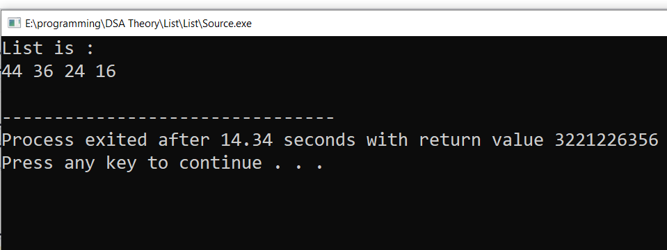
Time Complexity
Worst Case | Average case | Best Case
O(n) | Θ(n) | Ω(n)
Pre-Conditions:
List should not be empty.

Slide 9
Get Count
// Function to get the maximum number of Nodes in Linked List.
int getCount() const
{
return count;
}

Slide 10
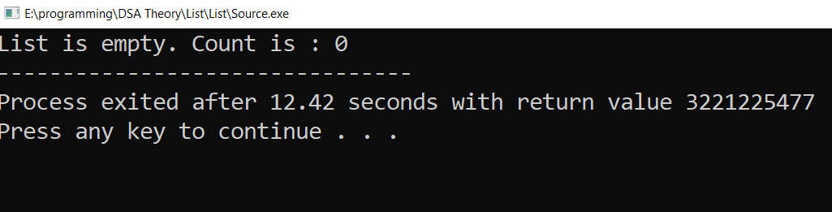
Time Complexity
Worst Case | Average case | Best Case
O(n) | Θ(n) | Ω(n)
Pre-Conditions:
List should not be empty.

Slide 11
Delete LinkedList
// Function to Delete Node from Linked List
void deleteList(Node *ptr)
// Running n times (n=Number of nodes)
{ if (ptr) // ptr=runner pointer
{
deleteList(ptr->next);
delete ptr;
}
}

Slide 12
Functionality
This function is working recursively and deleting all the nodes of the singly linked list .
Pre-Condition
The list must not be empty

Slide 13
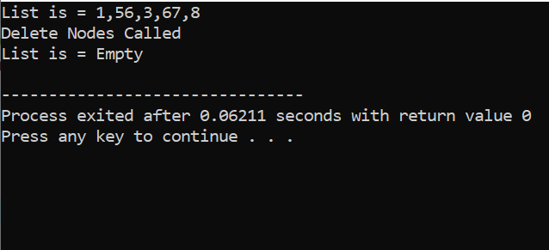
Post-Condition
Check if Linked List is empty.
Output
List gets empty.

Slide 14
Time Complexity
Worst Case | Average case | Best Case
O(n) | Θ(n) | Ω(1)

Slide 15
Destructor
// To Release Heap memory used by Linked List
cList::~cList()
{ // Running n times (n=Number of nodes)
void deleteList(Cnode *ptr);
deleteList(head);
}

Slide 16
Functionality
This function is working recursively and deleting all the nodes of the singly linked list .
Pre-Condition
The list must not be empty

Slide 17
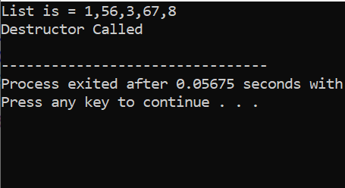
Post-Condition
Check if Linked List is empty.
Output
Linked List gets empty.

Slide 18
Time Complexity
Worst Case | Average case | Best Case
O(n) | Θ(n) | Ω(1)

Slide 19
Copy Constructor
ptr = head->next;
for (int i = 1; i < count; ++i)
{
dptr->next = new Cnode(*ptr);
dptr = dptr->next;
ptr = ptr->next;
}
dptr->next = NULL;
} }
//COPY CONSTRUCTOR
Clist::Clist(const Clist &src) :head(src.head), count(src.count)
{
if (count > 0)
{
Cnode *ptr, *dptr;
dptr = head = new Cnode(*src.head);

Slide 20
Functionality:
This function is working such that it is copying one list into the other.
Pre-conditions:
Passed argument must be of same class.
Argument should be passed by reference.
The list must not be empty
Argument should be passed by const.
Post-condition:
Check if the other object has copied items or not.
Output:
Nodes of one object are copied into the other object

Slide 21
Big Os:
Best case: O(1)
Average case: O(n)
Worst case:O(n)
Limitations:
This algorithm will only work if the list is not empty

Slide 22
Insertion
Inserts a given data at a specified position. Following are the ways a node can be inserted.
A node can be inserted in three ways
At the front of the linked list
After a given node
At the end of the linked list

Slide 23
Code
// Function to add new node at the front of Linked List.
cList & insertAtFront (Node *& ptr)
{
If (head != NULL)
{
ptr -> next = head;
head = ptr;

Slide 24
ptr = NULL;
++ count;
}
else {
cout << “ List is empty! ” << endl;
}
}

Slide 25
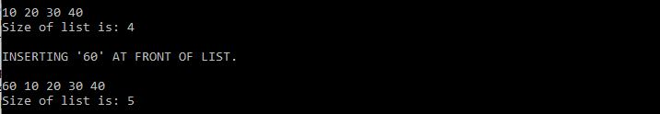
OUTPUT
Output of function to add node at front of list.

Slide 26
FUNCTIONALITY
// Function to add a new node at the end of Linked List
cList & insertAtEnd (Node *& ptr)
{
If ( head != NULL) // Checking if List is Empty
{
tail -> next = ptr; // Inserting Node at end
tail = ptr;

Slide 27
tail -> next = NULL; // Make tail->Next = NULL
ptr = NULL;
++ count;
}
else {
cout << “ List is empty! ” << endl;
}
}

Slide 28
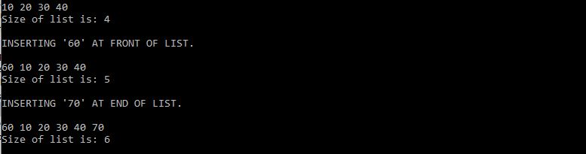
OUTPUT
Output of function to add node at end of list.

Slide 29
// INSERT THE VALUE AT CERTAIN INDEX
cList & insertAtPosition(int index, Node *& ptr)
{
if ( index <= 0 ) // If List is empty, Insert at the Start
{
insertAtFront (ptr);
return *this;
}

Slide 30
else {
if ( index > count ) { // If index is greater than Count
InsertAtEnd (ptr) // Insert at the end of List
return *this;
}
else {
CNode *rptr = head;
for ( int i = 1; i < index; ++i ) // Finding the Position
rptr = rptr -> next; //Where to insert Node

Slide 31
ptr -> next = rptr -> next;
rptr ->next = ptr;
++ count; //After increamenting increase list size
rptr = ptr = NULL;
return *this;
}
}
}

Slide 32
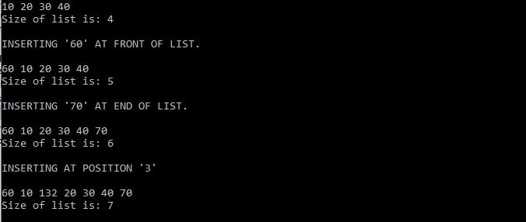
OUTPUT
Output of function to add node at specified position in the list.

Slide 33
Time Complexity
Best Case
Worst Case
Insert at front
Ω ( 1 )
O ( 1 )
Insert at end
Ω ( n )
O ( 1 )
Insert at specified position
O ( n )
Ω ( 1 )

Slide 34
Reverse
void & reverse()
{ isNotEmpty()==true;
Node>1== true;
Cnode ** ARR== new Cnoode*[node]
For (int i=0;i<node;i++) {ARR[i]=rptr}
For (int i=1;inext=ARR[i-1]}
Swap the head and tail nodes
}

Slide 35
Reverse ()
Time Complexity:
To Find the time complexity for a function in terms of n. We count the number of operation which the algorithm accomplish So we can find the Best, Worst and Average case: If we count above operation then the Best, average and worst case is O(n)

Slide 36
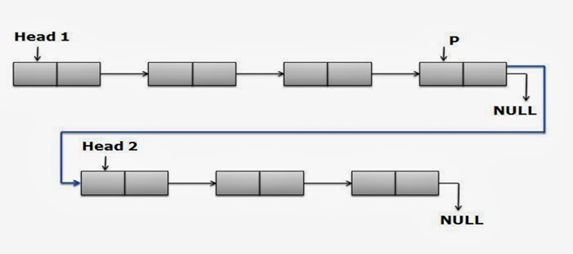
+ Operator Overloading
● Concatenation is the process of appending a second list to the end of the first list.

Slide 37
Algorithm to combine two linked lists
● Make the first linked list and insert data in it.
● Make the second linked list and insert data in it.
● Start from the top node and find the last node of the first linked list by searching the NULL (a->next == NULL) of nodes.
● Then change the element next to it to ‘b’ (a->next = b).

Slide 38
+ Operator Overloading
Preconditions:
IsEmpty() or IsNotEmpty() is required to check whether the list is empty or not.
Time Complexity:
O(n) where n is the number of nodes in the first list.

Slide 39
+ Operator Code
CList& operator+(const CList & robj)
{if(robj.head==NULL)
return *this;
if(head==NULL)
head=robj.head;
else{
CNode *rptr=head;
while(rptr->next!=NULL)
rptr=rptr->next;
rptr->next=robj.head;
robj.head=NULL;
}return *this;
}

Slide 40
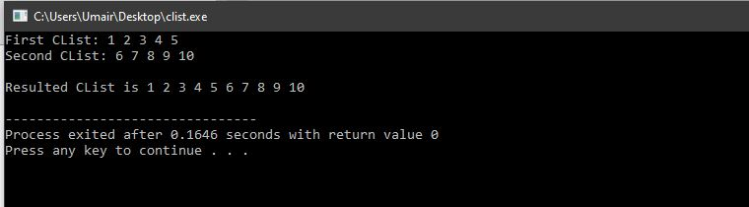
Output:

Slide 41
Primitive Operations in + operator:
CMP(node type): robj.head==NULL, head==NULL, rptr->next!=NULL
MMV (node type): head=robj.head, rptr=rptr->next, rptr->next=robj.head, robj.head=NULL
Return: return *this, return *this

Slide 42
Worst Case
 | CMP (node type) | MMV (node type) | Return
 | n+2 | n+3 | 2
SUM | n+2 | n+3 | 2
Total | 2n+7
Worst case w(n): 2n+7

Slide 43
Best Case
 | CMP (node type) | MMV (node type) | Return
 | 1 | 0 | 1
SUM | 1 | 0 | 1
Total | 2
Best case b(n): 2

Slide 44
Average Case
Calculations:
(w(n)+b(n))/2
(2n+7+2)/2
(2n+9)/2
n+4.5
Average case g(n): n+4.5

Slide 45
ASSIGNMENT OPERATOR
The assignment operator (operator=) is used to copy values from one object to another already existing object.

Slide 46
CODE
cList& operator = (const cList &ListRef)
{
if (this == &ListRef)
return *this;
if (true)
{ cList temp; temp.head = this->head; }
if (true)
{ cList temp; temp = ListRef ;
this->head = temp.head;
temp.head = NULL; }
return *this;
}

Slide 47
Pre-Conditions
IsEmpty() or IsNotEmpty() is required to check whether the list is empty or not.
Time Complexity
O(n) where n is the number of nodes in the Linked List.

Slide 48
Primitive Operations
CMP (Node Type)
this->rObj==&ListRef
MMV (Node Type)
temp.head = this->head,
temp = ListRef ;
this->head = temp.head;
temp.head = NULL
Return : return *this

Slide 49
Worst Case
 | CMP (Node Type) | MMV (Node Type) | Return
OPERATIONS | 1 | 4n | 2
SUM | 1 | 4n | 2
Grand Total | 4n + 1
Growth Of Function : 4n + 1
Time Complexity : O(n)

Slide 50
Best Case
 | CMP (Node Type) | MMV (Node Type) | Return
OPERATIONS | 1 | 0 | 1
SUM | 1 | 0 | 1
Grand Total | 1
Growth Of Function : 1
Time Complexity : Ω(1)

Slide 51
Average Case
( O(n)+Ω(n) ) / 2
= ( 4n+1+1 ) / 2
= ( 4n+2 ) / 2
= 2n+1
Growth of Function : 2n + 1
Time Complexity : Θ(n)

Slide 52
Remove Function
Like insertion, deleting a node from a linked list also involves various positions from where the node can be deleted. We can delete the first node, last node or a random kth node from the linked list.
After deletion, we need to adjust the next pointer and the other pointers in the linked list appropriately so as to keep the linked list intact.

Slide 53
Function to remove an element
{ delete head;
head=NULL;
last=NULL;
}else{
node *temp=head;
head=head->next;
delete temp;}
}
void remove(node *&head, node *&last){
if(isEmpty(head)){
cout<<"List is empty"<<endl;
} //Checking list is not empty
else if(head==last)

Slide 54
Function Analysis
Pre-Conditions:
First check list is not empty.
Time complexity:
Cost of accessing elements=O(n)
Remove from beginning=O(1)
Remove from end=O(n)
Remove from middle=O(n)

Slide 55
Limitations
1) It must accept a pointer to the start node as first parameter and node to be deleted as the second parameter i.e., a pointer to head node is not global.
2) It should not return a pointer to the head node.
3) It should not accept pointer to pointer to head node.

Slide 56
RemoveAt Function of linked list
for (int i = 1; i < index; i++)
{
List::moveForward();
}
Node* newNode = new Node();
newNode = currentNode;
// function for deleting the Node from the Index
bool List::deleteIndex(int index)
{ if (size != 1)
{if (index < size) // Checking of index
{
List::start();

Slide 57
Continuation of RemoveAt Function
else {
currentNode->getPrevNode()->setNextNode(currentNode->getNextNode());//
currentNode->getNextNode()->setPrevNode(currentNode->getPrevNode());//
currentNode = currentNode->getNextNode();//
}
if (index == 1) // For deleting first Node of List
{
headNode = headNode->getNextNode();
currentNode = headNode;// headNode->setPrevNode(0);//
}

Slide 58
Continuation of RemoveAt Function
List::end();
currentNode = currentNode->getPrevNode();
currentNode->
setNextNode(0);
delete newNode;
size--;
return true;}}
delete newNode;
size--;
return true;
}
else if (index == size)
{
Node* newNode = new Node();

Slide 59
Continuation of RemoveAt Function
// this else will work when List has only one Node
else
{
List::List();
return true;
}
return false;
}

Slide 60
Function Analysis
Time Complexity:
Remove by index. In this case we need to traverse list (O(index)) and remove item (O(1)). The total time is O(index). For arbitrary index it is O(n).

Slide 61
Operator []
Functionality:
By using this function we will access nodes in list by indexing. In this function list behave as an array as in array we refer element by indexing it for example arr[3] .In that same way we access list nodes by indexing it.
Pre conditions:
The precondition for this function is that the list should not be empty.If list is empty program will halt. So the list must contain one or more nodes before calling [ ] operator.
lnput:
Index of type int to access node in the list.

Slide 62
Operator []
Output:
Return the node at the given index and by calling this function in main we output the node data
Limitations:
Objects whose list can be built must be of node type.
We need additional data member count for counting number of nodes in list
Node have pointer of its type.
Suitable copy constructor
List must have print function in node class for debugging

Slide 63
Operator []
Time Complexity
There are three cases:
Worst case w(n)
Best case b(n)
Average case g(n)

Slide 64
Operator []
Primitive operations in operator []
Following are the primitive operations involved in the above algorithm:
Addition ADD4 : ++i
Comparison CMP4 : i<index , index<=0 , index>=count-1
Memory move MMV4 : index=count-1 , i=0
Memory move nodeType : rptr=rptr->next , rptr=head
Return : return *head , return NULL , return *rptr

Slide 65
Operator []
Worst case analysis
Worst Case w(n): 3n+8
 | ADD4 | CMP4 | MMV4 | MMV NodeType | Return
 | n | n+3 | 1 | n+1 | 3
SUM | n | n+3 | 1 | n+1 | 3
G-Total | 3n+8

Slide 66
Operator []
Best case analysis
Best Case b(n): 2
 | ADD4 | CMP4 | MMV4 | MMV NodeType | Return
 | 0 | 1 | 0 | 0 | 1
SUM | 0 | 1 | 0 | 0 | 1
G-Total | 2

Slide 67
Operator []
Average Case
Average Case g(n):
w(n)+b(n)/2
3n+8+2/2
1.5n+5

Slide 68
SwapNodesAt()
Swap function swaps two nodes of Singly linked list at given indexes.

Slide 69
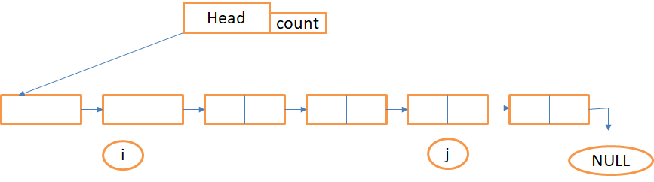
Swap Nodes
➢ Swapping Nodes i and j from Singly linked list of size n.

Slide 70
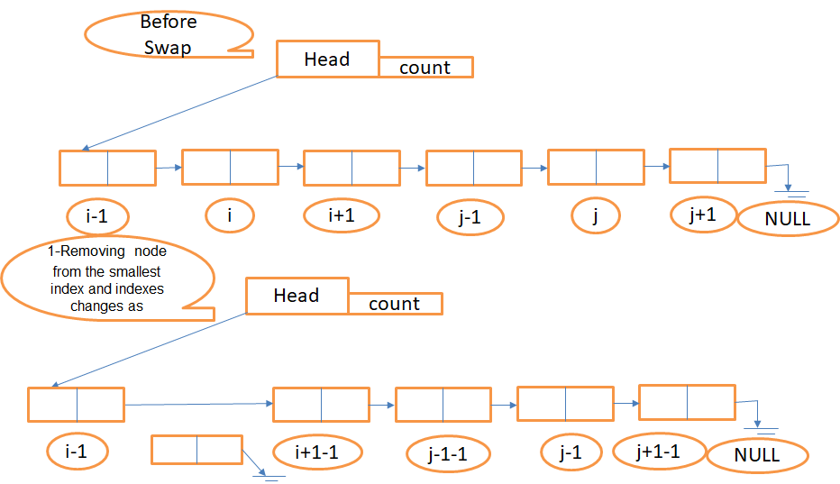

Slide 71
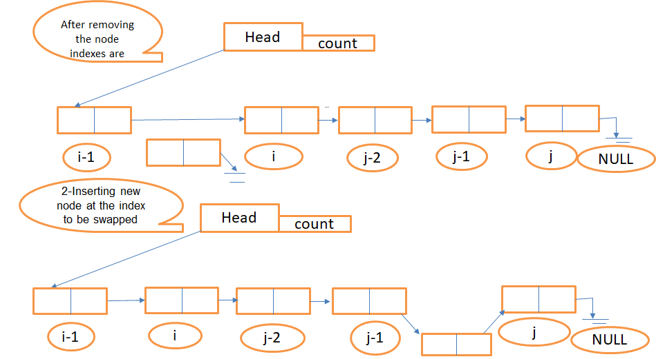

Slide 72
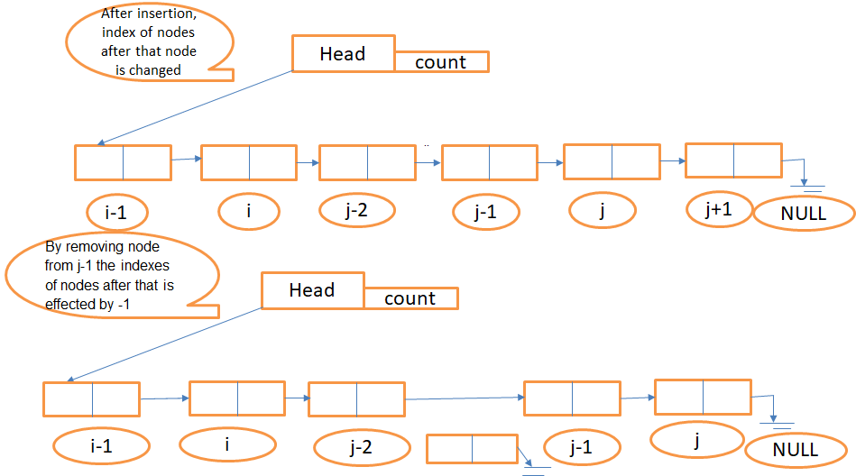

Slide 73
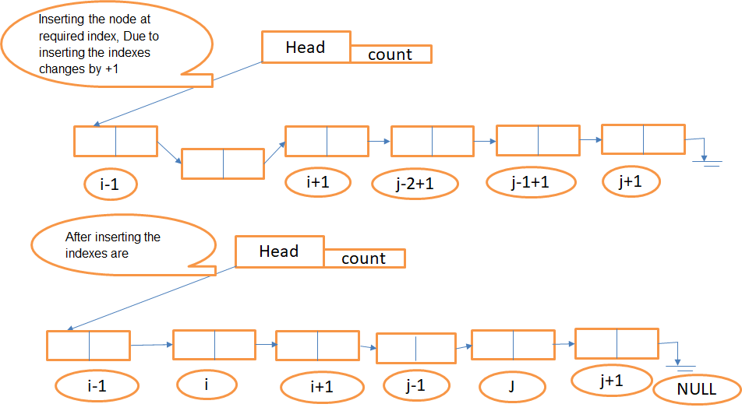

Slide 74
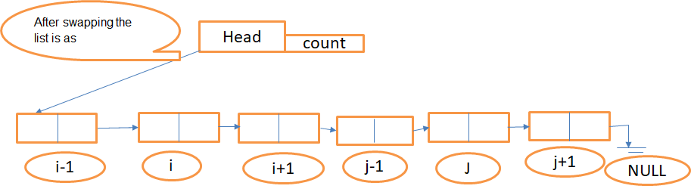
..

Slide 75
Code(1 of 3)
Clist& swapNodesAt(int index1, int index2)
{ //Swapping nodes at two indexes
if (index1 < 0) {index1 = 0; }
if (index2 < 0) { index2 = 0; }
if (index1 >= count) { index1 = count - 1; }
if (index2 >= count) { index2 = count - 1;
if (index1 == index2) { return *this; }

Slide 76
Code(2 of 3)
if (index1 < index2)
{
CNode *ptr = (RemoveAt(index1));
insertAt((index2 - 1), *&ptr);
ptr = (RemoveAt(index2));
insertAt(index1, *&ptr);
}

Slide 77
Code(3 of 3)
else
{
CNode *ptr = (RemoveAt(index2));
insertAt((index1 - 1), *&ptr);
ptr = (RemoveAt(index1));
insertAt(index2, *&ptr);
}

Slide 78
•Functionality:
By using this function we will swap nodes at given indexes. This function will take two indexes from user and return list after swapping .
•Pre conditions:
The precondition for this function is that the indexes must not be less than 0 or more than the size of the list. We will check for indexes if both the indexes are same so we return the list as it is.
•Input:
Two Indexes of type int to swap the nodes at.

Slide 79
Output:
A list with swapped nodes at given indexes.
Limitations:
•Two parameters of integer type are required.
•If the index is less than zero is considered as default index.
•If index is more than the size than last index is considered.
• A fully functional insertAt() and removeAt() is required.So, if these functions will not be working then this function will be of no use.

Slide 80
Primitive operations in swapNodesAt()
Following are the primitive operations involved in the above algorithm:
•Comparison CMP4 : index1<index2 , index1<0 , , index2<0 , index1>=count, index2>=count,index1==index2
•Memory move MMV4 : index1=count-1 , index2=count-1,index1=0,index2=0
•Memory move calling another function: insertAt(index2-1,removeAt(index1)), insertAt(index2,removeAt(index1)),
insertAt(index1-1,removeAt(index2)), insertAt(index1-1,removeAt(index2))
Return : return *this

Slide 81
SwapNodesAt()
Worst case analysis:
 | CMP 4 | MMV calling another function | Return | MMV4
 | 6 | n+8 | 2 | 4
Sum | 6 | n+8 | 2 | 4
Total | n+20
Worst Case w(n): n+20

Slide 82
SwapNodesAt()
Best case analysis:
M | CMP 4 | MMV calling another function | Return | MMV4
 | 1 | 0 | 1 | 0
Sum | 1 | 0 | 1 | 0
Total | 2
Best case b(n): 2

